Slide 1

- Presentation -

Slide 2




Who is BTS?
More Fabulous than Kimchi and Psy (Gangnam Style)
The group's 2018 album, LOVE YOURSELF 轉 'Tear', debuted at No. 1 on the Billboard200
and No. 10 on the BillboardHOT100 , marking the highest rank as Asian artist in history
2017 and 2018 Billboard Music Awards BBMAs - Top Social Artist
Current No.1 in Social 50 chart (https://www.billboard.com/charts/social-50)

Slide 3

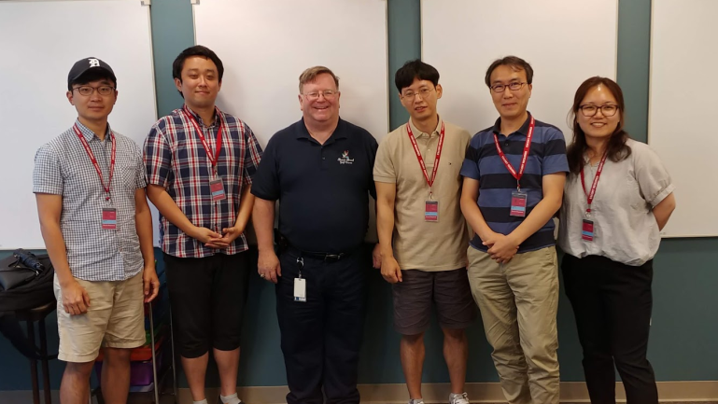
Team introductions
Team Goal
“Understanding of SDET Culture and Techniques”,
not dancing or singing like BTS.
Team member / Main Role
Clifford C Huff / Mentor
Sungho Chin / Team & Project Lead
Jonggoo Lee / Code Review Lead
Sujung Lyu / Refactoring Lead
Jinhyeok Yang / Static Analysis Lead
Hyoyeon Hwang / Plan & Test Lead
Ground Rules
Every member should be involved in every quality management process.
5 h for project / day, 1 Project Meeting / day, 1 Mentoring Meeting / week

Slide 4
Project introductions
Project Goal
Making Bug-free Game. (at least No Major, Critical defects)
Applying experience in this project to LG project
Quality Goals
Testability :
- Line coverage : 90%,
- Branch coverage : 80%
- Mutation coverage : 90%
Function’s Logical Correctness : Unit Test – Pass Rate : 100%
Function’s suitability for new features : 60%
Discussion of collected data : team Wiki, JIRA, Sonar, GIthub

Slide 5
Project Risk Management
Project Risk
Technical Risk
- Unclear Requirements made implementation and source modification difficult
➔ Modify and add requirements to clarify.
- Different proficiency of Java language among individual
➔ Assign job by individual skill level
Resource Risk
- Lack of time to implement all new features
➔ Separate members into developers and testers based on their specialty
- Limitation of LG internal development Tool
➔ Using external JIRA tools that team members feel familiar.
Product Risk
- Many unintended errors occurred during the integration of new functions
➔ Simultaneously execute integration test and system test.

Slide 6
Project Results - Quality activities
Code Review
Team (Technical) Review
Static Analysis
SonarQube
Refactoring & Rework
Static Analysis
Unit Test / Mutation Test
White Box testing (statement testing, branch testing)
JUnit4, Mockito, jacoco, PITest
Integration Test
Scenario testing (Black box testing)
JUnit4, Mockito, jacoco
System Test
Scenario testing, Ad-hoc testing, Combination testing,
Boundary Value Analysis

Slide 7

Project Plan

Slide 8

Project efforts
Efforts for Project
Planned effort : initial planned effort(h) for our project
Estimated effort : estimated effort(h) for each task by assignee
Actual effort : actual executed effort(h) for each task

Slide 9
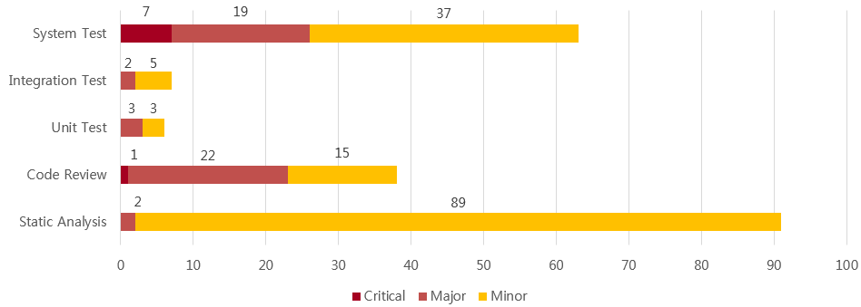
Project Results - Defect Categorization
Definition of Severity
Severity | Category | Defect Types
Critical | Functionality | Conflict to requirements
 | Reliability | Critical unstable issue. (can't proceed game)
Major | Maintainability | Structural Odd Code (no consistency with other code)
 | Maintainability | Static Analysis critical issue
 | Reliability | Memory handling issue
 | Functionality | Strange functional Operation
Minor | All defects except Critical, Major defect
Defects on each stages

Slide 10
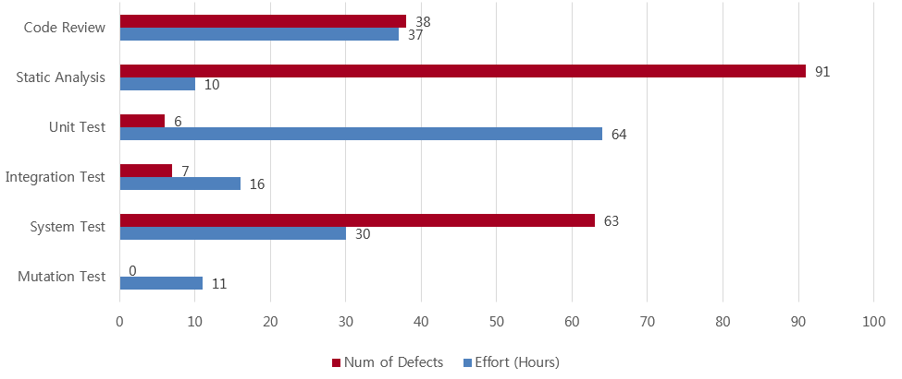
Project Results - Defect Categorization
Defects & Efforts
Implications
In Static Analysis, analyzing defect was time-consumed cost.
Intuitive Tests are more effective to detect major, critical defects.
We couldn’t detect critical defects about system Robustness by SDET technique.

Slide 11
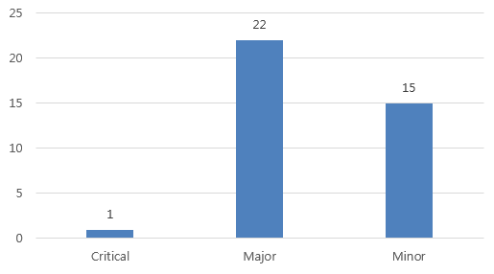
Quality activities - Code Review
Goal
Understanding system of Tartan Adventure.
Checking correspondence between Spec. and Code
Detecting Code defect
Resource
Planned Effort (6/21 ~ 26) : 50h (2h * 5days * 5 members)
Actual Effort : 36.5h
Outputs
Defect List
Lessons Learned
Vague requirements made code review hard.
Code review is one of good way to understanding System.
표 교체

Slide 12
Quality activities - Static analysis
Goal
To detect defects with less effort than dynamic testing
To integrate static analysis tools to the CI environment
Resource
Planned Effort: (6/21 ~ 26) 50h (2h * 5days * 5 members)
Actual Effort : 36.5h
Outputs
Defect List
Lessons Learned
Static analysis result is used as a basic data of refactoring.
It helped to manage coding convention and complexity.

Slide 13
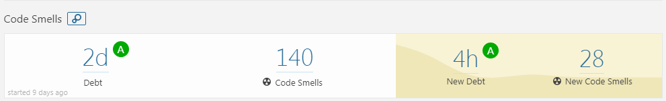
Quality activities - Refactoring & Re-Work
Goal
Improving Testability
Improving Code smells in SonarQube (by 1day debt)
Resource
Planned Effort(7/9 ~ 13) : 50h (2h * 5days * All members)
Actual Effort : 31h
Outputs
Refactoring status : Number of refactoring items (69) (ref. appendix.1)
SonarQube trend: (ref. appendix.2)
Lessons Learned
Refactoring is indispensable for Testability
Monitoring method for Field Status is needed to know changed status.
- Getter & setter methods are added
Method should return about that’s result of procedure.
Notes:
Monitoring method for Field Status is needed to know changed status.
- For this, We discussed for changing private fields to public fields
- Finally, we added getter & setter methods.

Slide 14
Quality activity – Unit Test
Goal
Verify the operation for function
Satisfying code coverage
Completion Criteria
Unit Test – Pass rate : 100%
Statement Coverage : 90% / Branch coverage : 80%
Resource
Planned Effort(7/16 ~ 20) : 50h (2h * 5 days * all members)
Actual : 64h
Outputs (ref. appendix.4)
Number of Unit Test : 241
Coverage : tatement : 88%, branch : 85%
Defect List
Lessons Learned
To effectively write the Unit test, we need a detailed specification.
Less defect is found as it progresses to code coverage rather than verifying function operation
Notes:
Actual / estimated Effort : 64h/73h
Should simple code be included in the Unit test?
→ Our team's decision: don’t include

Slide 15
Quality activity – Mutation Test
Goal
Satisfying Mutation coverage
Goal Coverage
80% line coverage 80% mutation coverage
Resource
Planned Effort(7/23) : 5h (5 h * 1 member)
Actual(7/23) : 11h (5.5h * 2 members)
Outputs (ref. appendix.5)
Mutation Test Result Report (PIT Summary)
Mutation Coverage : 71.3 % (for Game, Player, Item classes)
Lessons Learned
Improvement of Mutation coverage was not directly related to improvement of Unit Test defect detection.
→ selectively handle the remaining test case bugs provided by the PIT.
Explicit unit test case implementation of the parts to be checked and the degree of stub processing affected the mutation coverage.
Notes:
Estimated Effort : 10h (7/23, 2 members, each 5hours)
Affected Unit Test Case : GameTest.java - 46 , ItemTest - 3, PlayerTest.java - 4
Mutation Coverage : 55 -> 71.3 % (for Game, Player, Item classes)
The purpose of the mutation test is to check the fidelity of the test case.
test case verification of programs that contain a lot of logic to change the value
test case verification of safety-oriented programs (automotive, aviation-related programs, etc.).
예상 질문
유닛테스트 작성을 위해 디테일한 스펙을 정리 했는가?

Slide 16
Quality activity – Integration test
Goal
Integrate & Verify new features to make them working properly.
Completion criteria
Test Case Pass Rate : 100%
Resource
Planned Effort(7/18~20) : 45h (3h * 3days * all members)
Actual Effort : 16h
Outputs (ref. appendix.6)
Test Case : 11
Pass Rate : : 100 %
Defect List
Lessons Learned
In the tartan project, the modules are already integrated, should we do the integration test?
Notes:
New feature integration test case 및 defect 기준으로 수정
New feature 내용 위주로 재구성
기존 내용은 effort. 관련된 데이터 위주로 재사용

Slide 17
Quality activity – System test
Goals
Verify requirements from the user's perspective.
Especially, Use-Cases will be mainly validated.
Completion criteria
Test case pass rate : 100%
Resource
Planned Effort : 40h ( 5h * 4cycles * 2 members)
Actual Effort : 50h
Outputs
Test Cases : 492
Current Pass Rate : 100 %
Defect List
Lessons Learned
Ambiguous requirements and unexpected gaming behavior made code review hard.
Notes:
Scenario : 29, Action/Item : 434, Game Config. : 29
시나리오 : palyer와 designer의 시나리오 흐름도를 기반으로
시나리오의 시작에서 종료까지 path를 타도록 TC를 생성
Action/Item : 게임 진행시 필요한 세부 동작에 대한 test case. 모든 아이템(29개)의 action(14)을 실행하고, 추가로 item 없는 action에 대해서도 test하기 위한 tc 생성
Game Config. : designer의 시나리오과 관련 있음. 디자이너가 만든 게임의 valid 를 check 하는것에 대한 세부 TestCase를 분리한것.

Slide 18
New Feature Architecture
Msgs & cmds
msgs & cmds for offline
New modules
msgs & cmds for online
user
Game Config Json
Game Config Json
Game Config Json
Offline
User
online
User
Tartan Terminal
Socket
Game
Process
Custom Game
System.in & out
Tartan Server
System.out
System.in
User DB
Socket
Socket
User Management
Socket
Game
Game
Tartan Client
Player
Save Json
Save&Load
Player
Game Configuration
Custom Game Configuration
Room
Item
Room
Item
Game Thread

Slide 19





Overall Course Lesson & Learned
I got the idea that quality activities could be
more enjoyable than development
- Sungho chin
I impressed about how Top level SW companies make
effort to ensure SW Quality. Applying valuable
techniques to my work is my homework. - Jonggoo Lee
I learned about various techniques and tools
It seems to be about to lead ‘well’ in collaboration.
- Sujung Lyu
It was nice to be able to study intensively.
I will try to apply various quality techniques
appropriately to actual projects. - Jinhyeok Yang
It was a good experience to work SDET during project.
I will try to apply what I learned in this course
to my work. - Hyoyeon Hwang

Slide 20
Q&A
Thank you for your attention!!

Slide 21
Tools
CI : Github + Jenkins (http://18.210.196.163:8080)+ sonaQube
Source repository : github (https://github.com/sunghochin/TartanAdventure)
Quality Tool : SonarQube (http://18.210.196.163:9000/projects)
document configuration : wiki page (https://sdet-bts.atlassian.net/wiki/spaces/SDET/overview)
issue tracker : jira (https://sdet-bts.atlassian.net/secure/RapidBoard.jspa?projectKey=SDET&rapidView=1)
Coverage library : jacoco, pitest
Auto trigger build
Static analysis
build
Coverage integration
source commit
Measure coverage

Slide 22
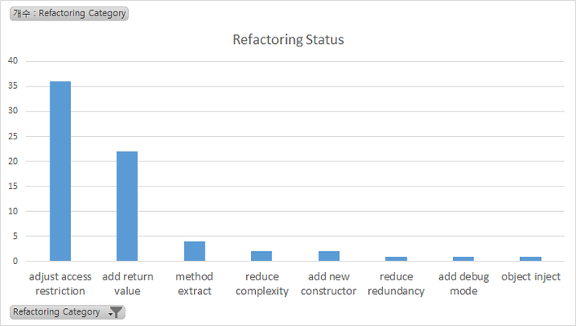
Appendix 1. Refactoring & Re-Work
Refactoring Status
Category | num | Graph
adjust access restriction | 36
add return value | 22
method extract | 4
reduce complexity | 2
add new constructor | 2
reduce redundancy | 1
add debug mode | 1
object inject | 1

Slide 23
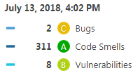
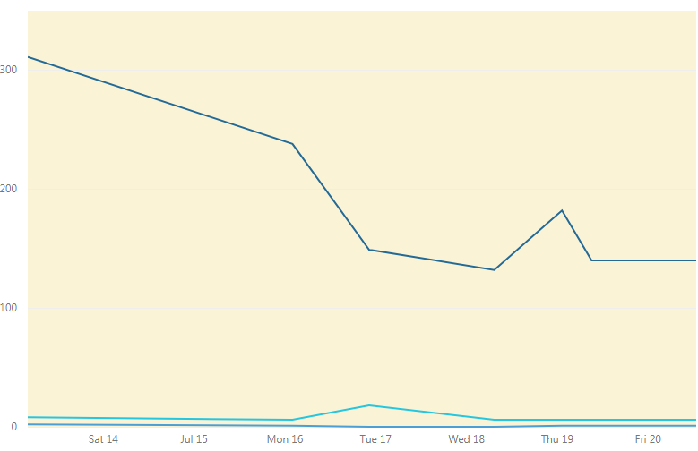
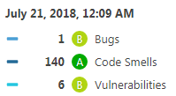
Appendix 2. Refactoring & Re-Work
SonarQube Trand

Slide 24
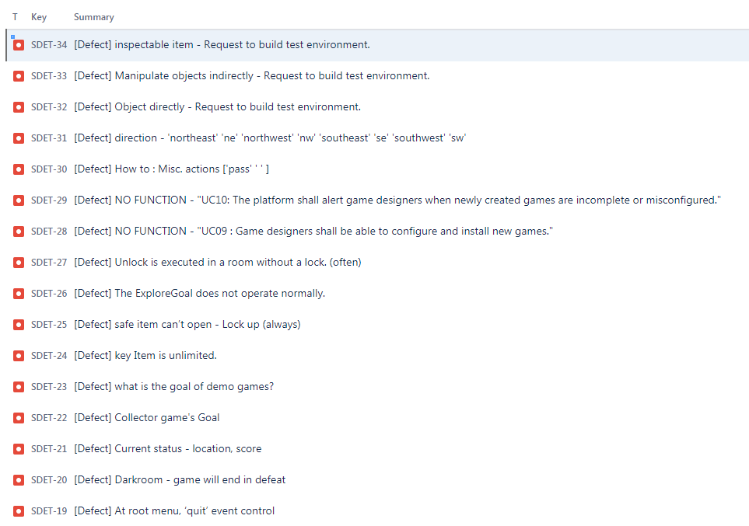
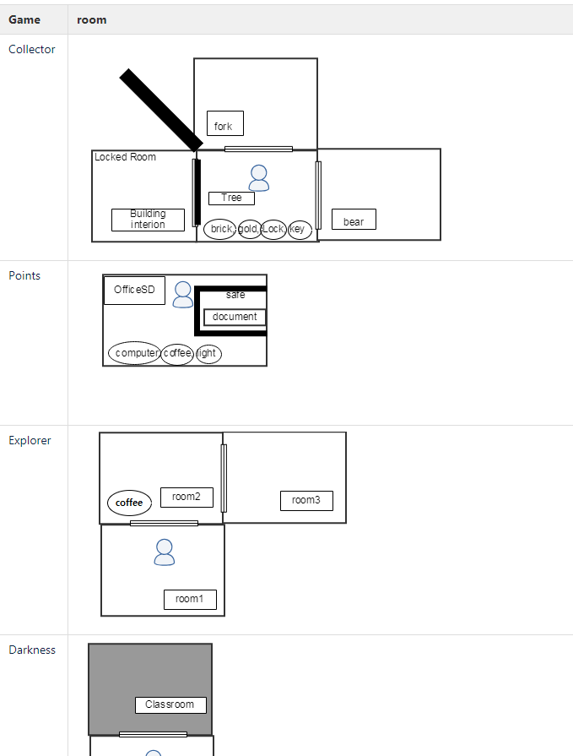
Appendix 3. Pre-Test outputs
Defect : 16
Game Map

Slide 25
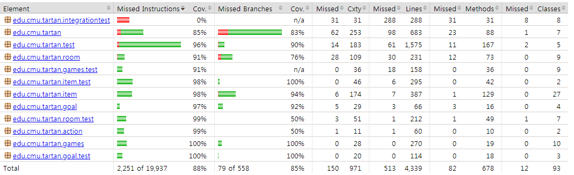
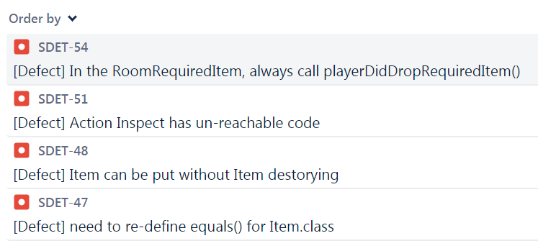
Appendix 4. Quality activity – Unit test
Coverage
Defect list
Notes:
예상 질문
유닛테스트 작성을 위해 디테일한 스펙을 정리 했는가?

Slide 26
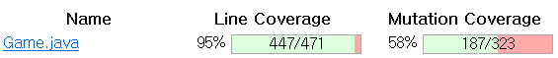
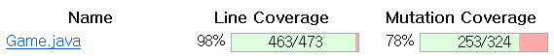
Appendix 5. Quality activity – Mutation Test
Before Coverage
After Coverage
Notes:
예상 질문
유닛테스트 작성을 위해 디테일한 스펙을 정리 했는가?

Slide 27
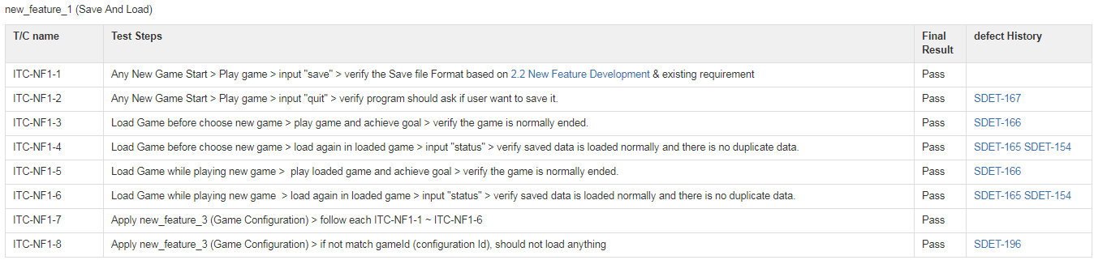
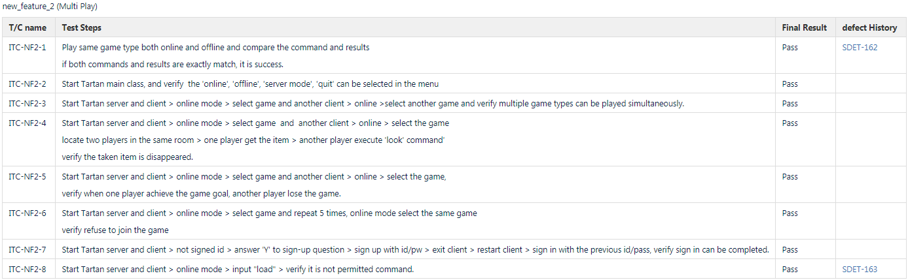
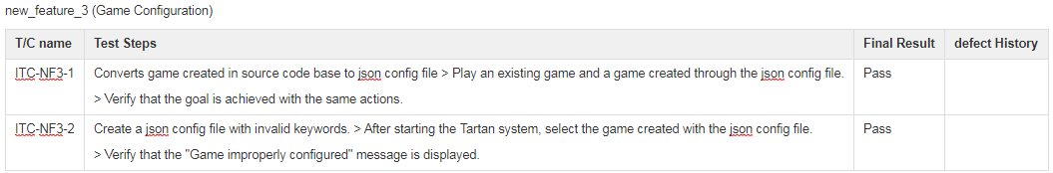
Appendix 6. Quality activity – Integration test
Test case
Notes:
예상 질문

Slide 28
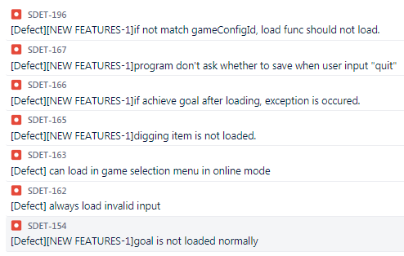
Appendix 6. Quality activity – Integration test
Defect List
Notes:
예상 질문

Slide 29
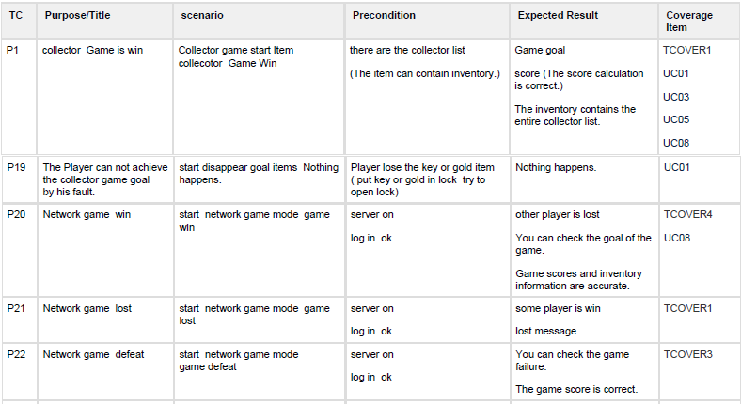
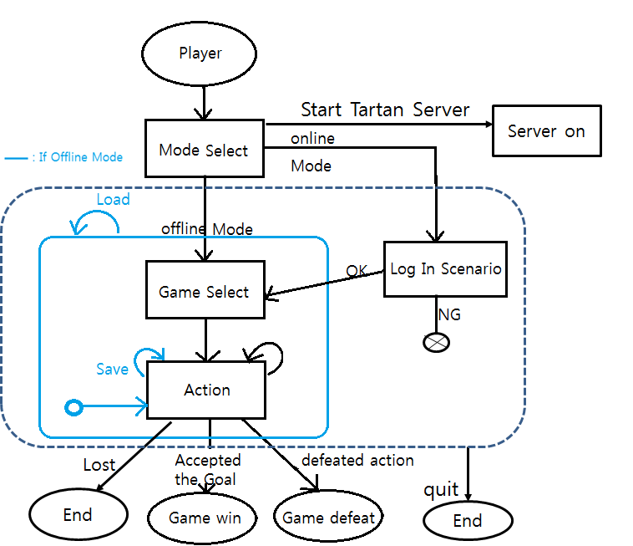
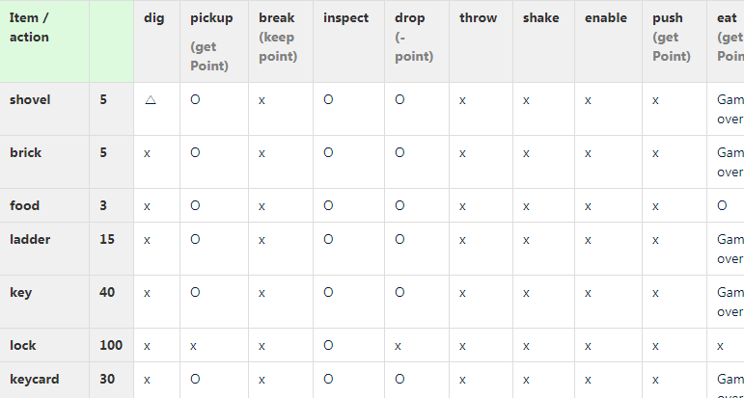
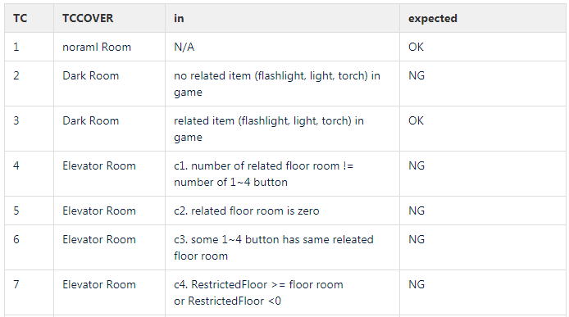
Appendix 7. Quality activity – System Test TC
Scenario
Action & Item
Game Config.
Notes:
예상 질문

Slide 30
Appendix 8. Quality activity – System Test Defect
Defect list : 66 (critical : 7 , major : 21, minor : 37)
Issue key | Summary | Priority
SDET-195 | [Defect] network game : safe item - error pin number -> game lock up | Highest
SDET-29 | [Defect] NO FUNCTION - "UC10: The platform shall alert game designers when newly created games are incomplete or misconfigured." | Highest
SDET-28 | [Defect] NO FUNCTION - "UC09 : Game designers shall be able to configure and install new games." | Highest
SDET-27 | [Defect] Unlock is executed in a room without a lock. (often) | Highest
SDET-26 | [Defect] The ExploreGoal does not operate normally. | Highest
SDET-25 | [Defect] safe item can?셳 open - Lock up (always) | Highest
SDET-200 | [defect] obscured game -> passage room in explored goal list is not game | Highest
SDET-203 | [Defect] save/load : rooms visit information error. - at load time, current room is in room visited. | High
SDET-202 | [Defect] save/load : point cal error - elevator game 6point save -> continue game. 8 point -> load game score 14 | High
SDET-199 | [Defect] network game - When do network games initialize? | High
SDET-194 | [Defect] requirement item room - There are no that item in the inventory. -> action error | High
SDET-182 | [Defect] log in - pw error -> unlimited retry | High
SDET-179 | [Defect] room releated - same direction multi room : no error | High
SDET-178 | [Defect] obscured room - obscuringItem : dynamite is not action | High
SDET-176 | [Defect] requireditem room - not to set the required item | High
SDET-161 | [Defect] collect game load -> play -> error about goal | High
SDET-142 | [Defect] Explorer game -> quit -> explored information is error (ofthen) | High
SDET-122 | [Defect] installed item in safe -> remove action -> error status | High
SDET-121 | [Defect]'eat action' point action diffent | High
SDET-112 | [Defect] Dig action error -> get duplicate items | High
SDET-111 | [Defect] Dig action - Error from the second action | High
SDET-110 | [Defect] remove action error | High
SDET-108 | [Defect] break pot -> score error | High
SDET-90 | [Defect] Darkness Win/Defeat condition & Explore Goal | High
SDET-87 | [Defect] need to add GameConfiguration : RoomExcavatable.java | High
SDET-53 | [Defect] need to change RoomExcavatable.java (dig items are not added in Room item) | High
SDET-52 | [Defect] need to change game.java if use item description | High
SDET-22 | [Defect] Collector game's Goal | High
Notes:
예상 질문

